Slide 1
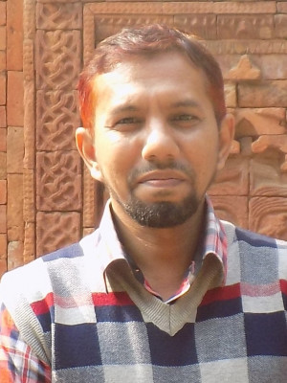

Project Supervisor Dr. Mir Md. Jahangir Kabir Professor Dept of Computer Science and Engineering
Doctor of Philosophy (Ph.D.) in Computing and Information Systems, 2013-2016 University of Tasmania, Australia.
Master of Science (M.Sc.) in INFOTECH 2006-2008 Major: Communication Engineering and Media Technology University of Stuttgart, Germany.
Bachelor of Science(B.Sc.) in Computer Science and Engineering 2000-2004 Rajshahi University of Engineering and Technology, Bangladesh
Research Interest:
Data Mining
Evolutionary Algorithms
Machine Learning
Artificial Intelligence
Rajshahi University of Engineering and Technology
Dept of Computer Science and Engineering

